Slide 1
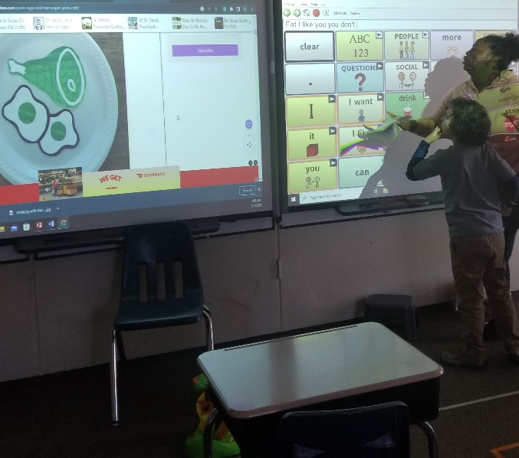
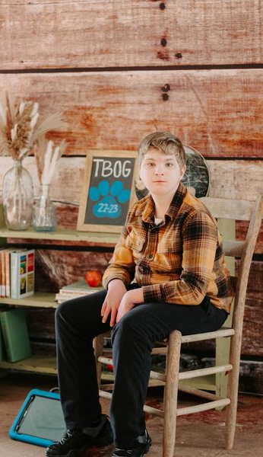
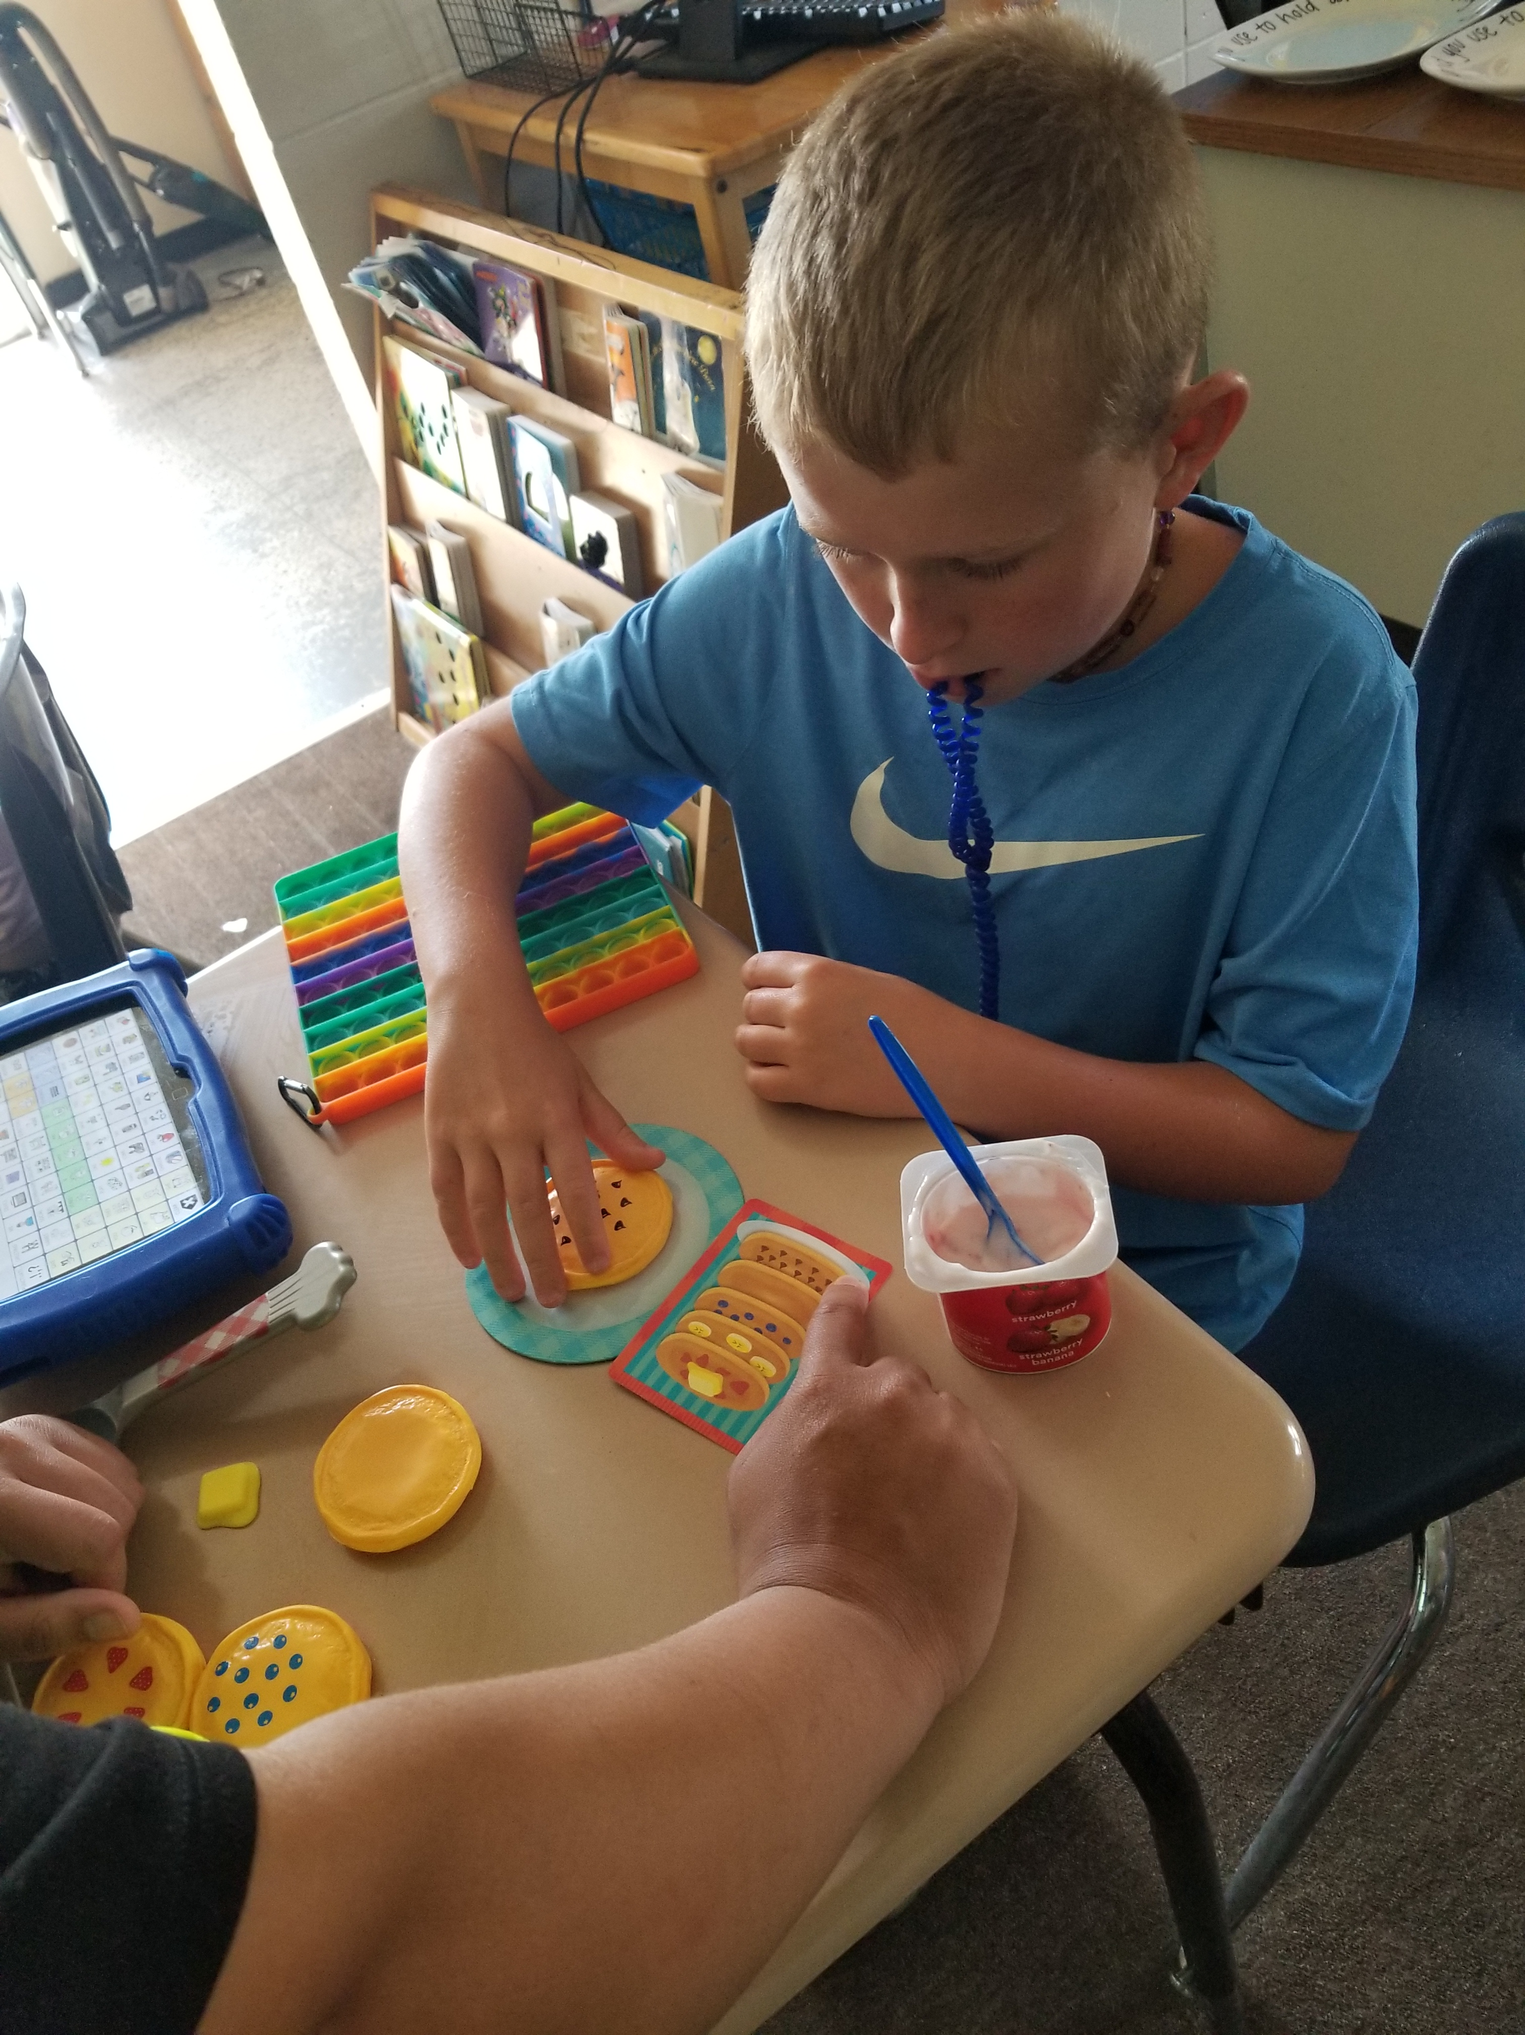
Our mission is
person centered communication
Speech/communication-based classroom:
High, mid and low-tech communication systems in the classroom
One to one Communiation system
Language is taught through a multimodal system that supports your child’s voice
We use symbol supported learning system
Student behavior support
Teaching boundaries by respecting the students' needs
Students are given individual spaces in the classroom that belong to them
Supports offered to increase students executive functioning skills
Data driven Behavior Intervention Plans
.
The Bridge of Georgia
Learning Fundamentals and Early foundations program
109 Blaine St.
Monroe, GA 30655
(770) 266-3390
Amanda.boyd@thebridgeofgeorgia.org
Notes:
To change this brochure, replace our sample content with your own. Or, if you'd rather start from a clean slate, press the New Slide button on the Home tab to insert a new page. Now enter your text and pictures in the empty placeholders. If you need more placeholders for titles, subtitles or body text, copy any of the existing placeholders, then drag the new one into place.
And did you notice we made fold marks for you? They are really light, but if you don’t like them showing on your brochure, select and delete them before you print.

Slide 2
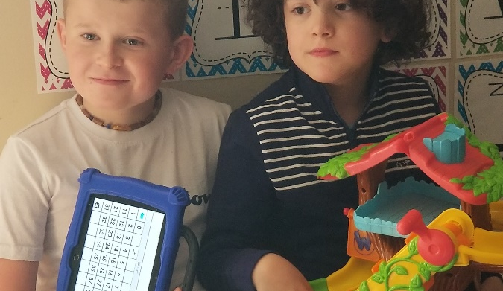
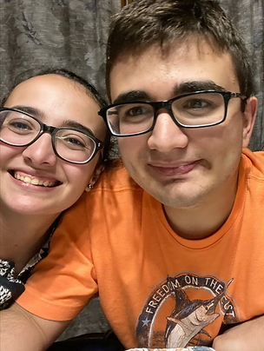
What our program offers your child and family:
Class Schedule
ABA services include:
Morning Class (Group A)
8:00-8:15 Unpack carpool
8:15-8:45 Calendar time
8:45-9:00 Break
9:00-9:30 Whole group reading 9:30-10:00 Recess
10:00-10:30 Social Skills
10:30-11:00 Chores
11:00-11:30 Lunch
11:30-12:00 Specials
12:00- 3:30 ABA
The focus of this program is meeting your child where they're at, we build you a data driven map to your child's success in the classroom and life. We begin with teaching them communication strategies, structure and life skills. We believe that every child can be successful with the right support system focused on them.
Board Certified Behavior Analyst (BCBA) creates therapeutic plans individualized for every individual
Program implementation through nationally certified team of Registered Behavior Technicians (RBTs)
School and BCBA meet regularly to ensure generalization across settings
RBTs and BCBA have been trained in complex communication needs and AAC implementation
Participants must qualify for at least 25 hours of ABA per week
Therapy is billed through insurance
During school calendar, your child will receive approximately 3.5 hours of ABA therapy each day
Afternoon Class (Group B)
8:00-1130 ABA
11:30-12:00 Lunch
12:00-12:30 Calendar Time
12:30- 1:00 Specials
1:00-1:30 Whole Group reading 1:30-2:00 Recess
2:00-2:30 Break
2:30-3:00 Social skills
3:00-3:30 Chores pack up
Additional Support:
Parent involvement in goals
Once a quarter data parent meetings about you students’ progress
Once a quarter parent group meetings offering family support strategies
Joint meetings with school and therapy team.
Occupational Therapy and Speech are offered when deemed medically necessary. These services are also billed through your child's insurance.

